Slide 1
Personal Software Process
for Engineers: Part I
Estimating with PROBE I
SM

Slide 2
Lecture Topics
Planning overview
Why estimate size?
Size estimating principles
The PROBE estimating method
Size estimating proxies
Estimating examples

Slide 3
Planning Overview
Plans
  allow you to make commitments that you can meet
  provide the basis for agreeing on job scope, schedule, and resources
  guide the work
  facilitate progress tracking and reporting
  help ensure that key tasks are not overlooked

Slide 4
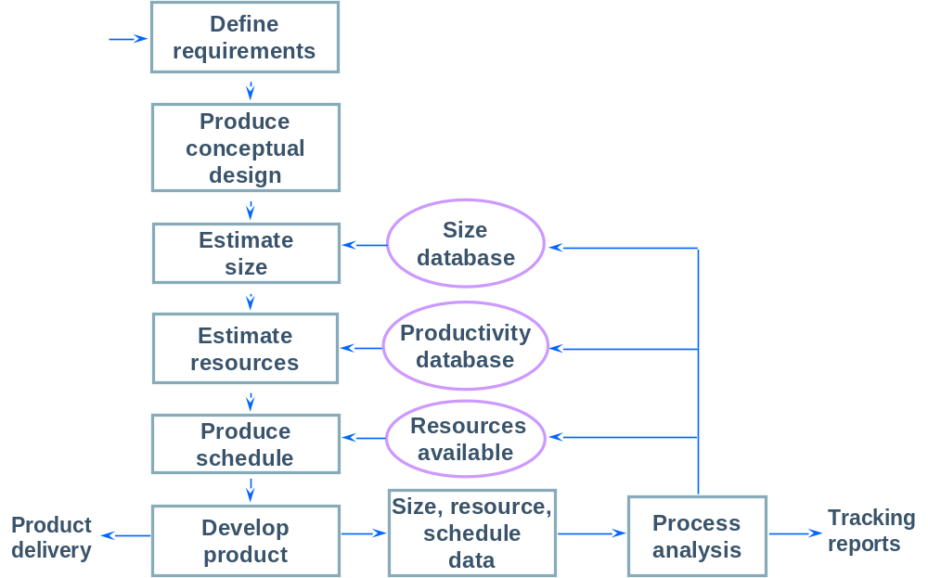
The Project Planning Framework

Slide 5
The Planning Process
Before making the plan, you must have a requirement.
  The better the requirement, the better the plan.
  With ill-defined requirements, expect to make frequent plan updates.
Plans are most accurate when based on size estimates and historical data.
With a size estimate and historical data, you can
  identify the data on the most similar prior work
  base the resource estimate on these data

Slide 6
Size Estimating Principles -1
Estimating is an uncertain process.
  No one knows how big the product will be.
  The earlier the estimate, the less is known.
  Estimates can be biased by business and other pressures.
Estimating is an intuitive learning process.
  Ability improves with experience and data.
  Some people will be better at estimating than others.

Slide 7
Size Estimating Principles -2
Estimating is a skill.
  Improvement will be gradual.
  You may never get very good.
The objective is to become consistent.
  You will then understand the variability of your estimates.
  You seek an even balance between under- and overestimates.

Slide 8
Balanced Estimates
40
40
Majority are under-
estimating
Balance of over- and
underestimates
Much tighter balance
around zero
PSP 0
20
20
0
0
-
-
200%
200%
-
-
100%
100%
0%
0%
100%
40
100%
40
PSP 1
20
20
0
0
-
-
200%
200%
-
-
100%
100%
0%
0%
100%
40
100%
40
PSP 2
20
20
0
0
-
-
200%
200%
-
-
100%
100%
0%
0%
100%
100%

Slide 9
Size Estimating Principles -3
The advantages of using defined estimating methods are that you
  have known practices that you can improve
  have a framework for gathering estimating data
  can consistently use historical data to produce balanced estimates

Slide 10
Estimating with PROBE
The PSP uses the PROBE method to estimate and plan projects.
PROBE stands for PROxy Based Estimating.
PROBE uses proxies to estimate program size and development time.
A good proxy will help you to make accurate estimates.

Slide 11
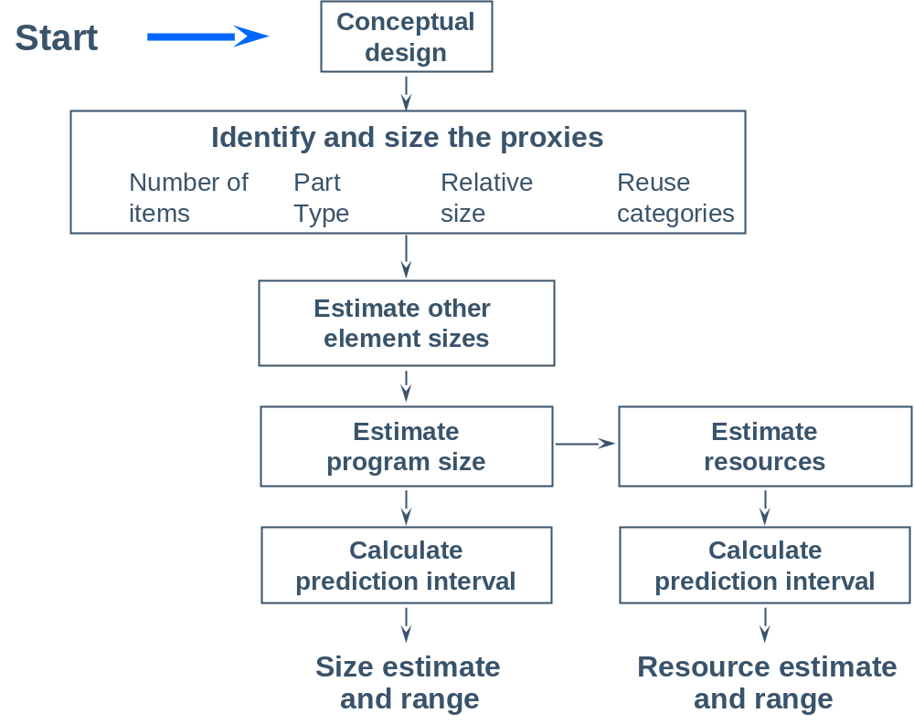
The PROBE Estimating Method

Slide 12
Conceptual Design -1
The first estimating step is to make a conceptual design.
  relate the requirements to the product
  define the product elements that will produce the desired functions
  estimate the size of what you plan to build
For most projects, the conceptual design can be produced relatively quickly.
For the PSP exercise programs, try to limit your conceptual design time to 10, or at most 20, minutes.

Slide 13
Conceptual Design -2
To make a conceptual design, identify the product functions and the program parts needed to produce them.
In effect, you say: “If I had the following parts, I could build this product.”
Then, compare these parts to programs you have already written and estimate their sizes.
Finally, combine the part estimates to give total size.
If you do not understand the product well enough to make a conceptual design, you do not know enough to make a plan.

Slide 14
Size Estimating Proxies -1
The basic issue
  Good size measures are detailed.
  It is generally hard to visualize product details early in a project.
Alternatives
  Wait to estimate until you have the detail.
  Make your best guess.
  Identify a suitable proxy.

Slide 15
Size Estimating Proxies -2
A good proxy should correlate closely to development costs.
A good proxy should be easy to visualize early in development.
It should also be a physical entity that can be measured.

Slide 16
Example: Building Costs
Problem
  The builder needs to know the floor area (in sq. ft.) to estimate the cost of construction.
  Clients normally cannot describe their needs in square feet.
  They usually can describe the type and number of rooms they want.
Solution
  Use rooms as a proxy for size.
  Use historical (typical) data to translate from rooms to square feet.
Notes:
To explain how proxies work for estimating, let's look at an example from outside the software field.

Slide 17
Example: Customer Requirements
Bedrooms: | 1 large, 2 medium, and 1 small
Bathrooms: | 1 large and 2 medium
Kitchen: | 1 medium
Living room: | 1 large
Dining room: | 1 medium
Family room: | 1 large
Utility: | 1 medium
Notes:
A client might have the following requirements for their new house.

Slide 18
Historical Building Data
 | Small | Medium | Large
Bedrooms | 90 | 140 | 200
Bathrooms | 25 | 60 | 120
Kitchens | 100 | 130 | 160
Living rooms | 150 | 250 | 400
Dining rooms | 100 | 140 | 200
Family rooms | 150 | 240 | 340
Utility | 25 | 50 | 80
Notes:
The builder can use historical data to build this table showing typical room sizes.

Slide 19
Proxy Calculation
Bedroom | 1 large | = | 1 x | 200 | = | 200
Bedroom | 2 medium | = | 2 x | 140 | = | 280
Bedroom | 1 small | = | 1 x | 90 | = | 90
Bathroom | 1 large | = | 1 x | 120 | = | 120
Bathroom | 2 medium | = | 2 x | 60 | = | 120
Kitchen | 1 medium | = | 1 x | 130 | = | 130
Living room | 1 large | = | 1 x | 400 | = | 400
Dining room | 1 medium | = | 1 x | 140 | = | 140
Family room | 1 large | = | 1 x | 340 | = | 340
Utility | 1 medium | = | 1 x | 50 | = | 50
 |  | Total (sq. ft.) |  |  | = | 1870
Notes:
We can combine the two sets of information to calculate the estimated area of the client's new house.
Could animate this to fill in the table in stages. Start with the first 2 columns, then add the rest of each row (row 1, row 2, then the rest, with total row as final step)

Slide 20
Example: The Builder’s Estimate
The first estimation step provides the builder with the proxy data for room size.
However, there are many other cost elements in home construction.
Builders typically have extensive data to relate room size to the other building costs.
With agreed initial plans, builders typically require detailed architectural specifications and estimates before quoting a price.
Notes:
For software development, we need to identify suitable proxies.

Slide 21
Example Product Proxies
Classes, functions, and procedures
Product elements
  database elements
  screens, reports, scripts, files
  book chapters
Notes:
For software development, we need to identify suitable proxies.

Slide 22
Classes as Proxies -1
Correlation with development hours
  Numbers of classes correlates reasonably well.
  Class size correlates very closely.
  Class size can be estimated using historical data.
  The program size estimate is then calculated from the historical relationship between total class size and program size.
With a good correlation, calculate program size from the relationship between class size and program size.

Slide 23
Classes as Proxies -2
When classes are selected as application entities, they can be visualized early in development.
Functions and procedures can often be estimated in the same way.
Classes, functions, procedures, and their sizes can be automatically counted.

Slide 24
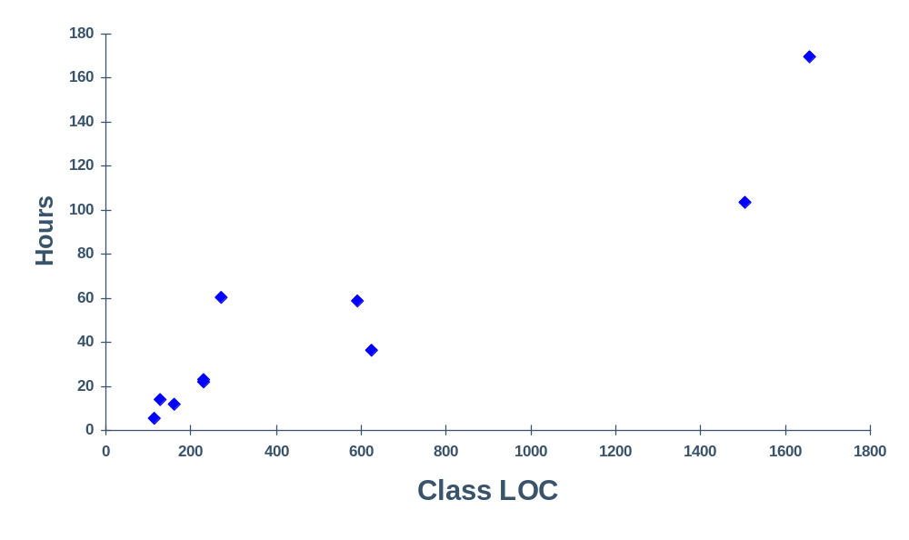
Class LOC Correlation With Development Hours

Slide 25
Other Example Proxies
Possible candidates
  screens, reports, scripts, files
  book chapters
If the number of items correlates with development, you estimate the number of items.
With a suitable proxy size measure, you can often estimate proxy size.

Slide 26
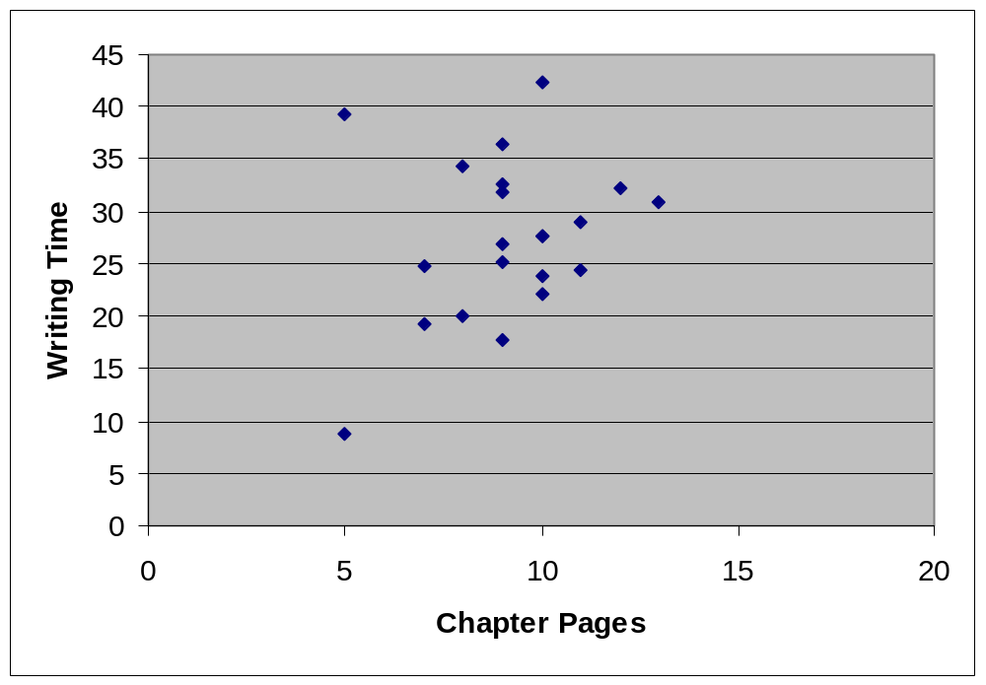
Chapter Pages Versus Time

Slide 27
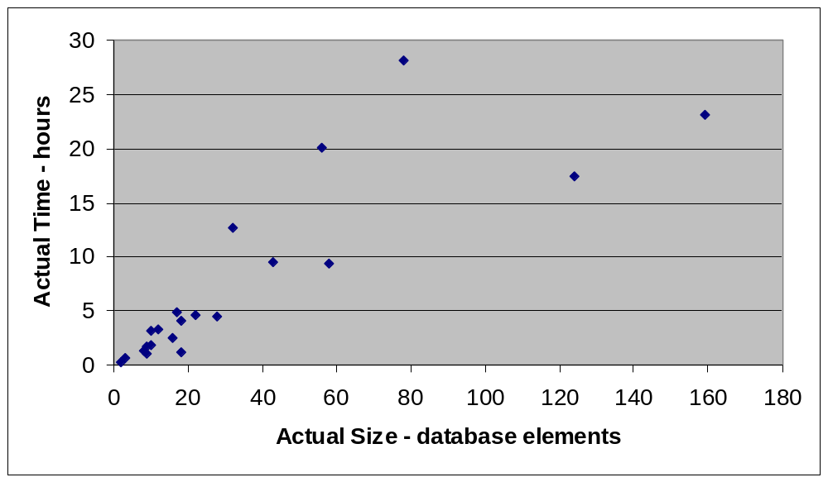
Database Elements Versus Time

Slide 28
Estimating with Proxies
Once you have selected a proxy, you must
  obtain proxy data
  organize the data for use in estimating
  use the data to estimate the size of the proxies in the new program
  combine the proxy estimates into the product estimate
  make a resource estimate
  produce a project plan
The PROBE method shows you how to perform these steps.

Slide 29
Organizing Proxy Data
A common way to estimate is to
  break the planned product into parts
  relate these planned parts to parts you have already built
  use the size of the previously built parts to estimate the
  sizes of the new parts
To do this, you need size ranges for the types of parts you typically develop.
For each product type, you also need size ranges to help judge the sizes of the new parts.

Slide 30
Example C++ Class Size Ranges
LOC per item
Type | VS | S | M | L | VL
Calculation | 2.34 | 5.13 | 11.25 | 24.66 | 54.04
Data | 2.60 | 4.79 | 8.84 | 16.31 | 30.09
I/O | 9.01 | 12.06 | 16.15 | 21.62 | 28.93
Logic | 7.55 | 10.98 | 15.98 | 23.25 | 33.83
Set-up | 3.88 | 5.04 | 6.56 | 8.53 | 11.09
Text | 3.75 | 8.00 | 17.07 | 36.41 | 77.66

Slide 31
Estimating Program Size
Just as homes have square feet that are not in rooms, programs have code that is not in the program parts.
  includes
  declarations
  other overhead functions
The development job, however, must also produce this overhead code.
The size of this additional overhead code is usually proportional to the size of the program’s parts.

Slide 32
Estimating Development Time
With sound estimating methods, actual program size will be closely related to estimated program size.
The differences will be due to the overhead code and the estimating error.
Actual development time is also often related to estimated program size.
Again, with sound methods, the differences will be largely due to overhead activities and estimating error.

Slide 33
Statistically-Based Estimates
PROBE uses historical data, linear regression, and the prediction interval to produce estimates of known accuracy.
Regression provides the best fit, or minimum variance, of a line to these data.
The variance of the data is used to determine the likely estimation error.
The greater the variance, the larger the likely error.

Slide 34
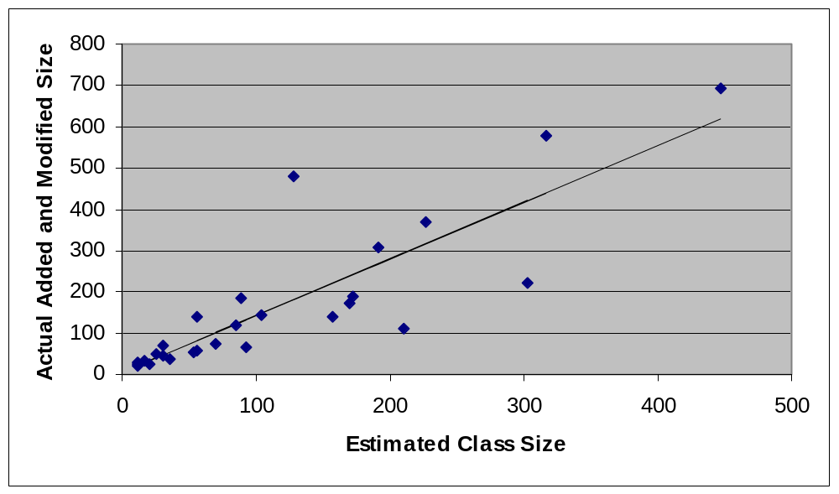
Regression Line for Program Size
27 C++ programs

Slide 35
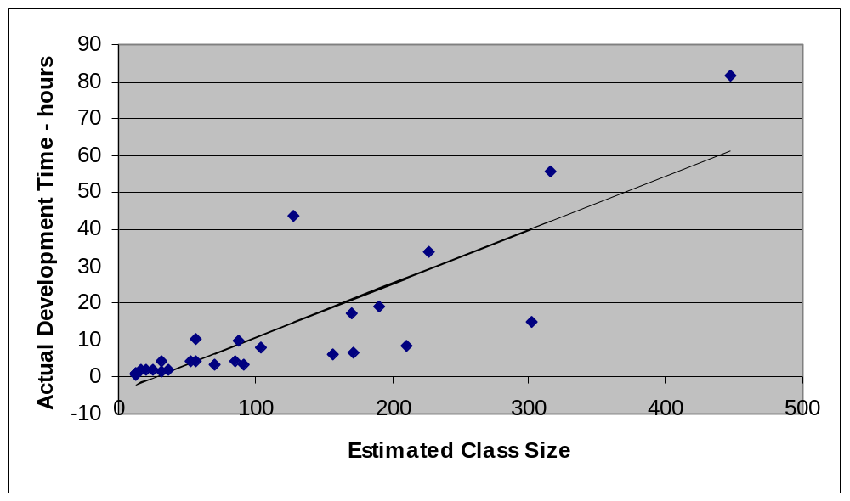
Regression Line for Development Time
27 C++ programs

Slide 36
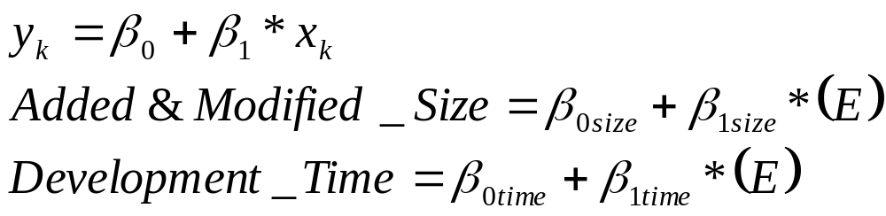
Estimating Size and Time -1
To project a program’s size or development time, find the equation for the regression line.
Then use the regression formula to project size and time.
E is the estimated proxy size.

Slide 37
Estimating Size and Time -2
Calculate the regression parameters β₀ and β₁ from data on previously developed programs.
For x, use estimated proxy size (E).
For y, use the actual
    added and modified size for the size estimate
    total development time for the time estimate
Calculate two sets of β₀ and β₁ regression parameters: one for size and the other for time.

Slide 38
Calculating Total Program Size
Total program size includes added, modified, deleted, base, and reused code.
When modifying an existing program, base code is the size of the unmodified existing program.
When modifying programs, include their unmodified size in base code and not in reuse.
While base code is a form of reuse, the PSP only counts unmodified code from the reuse library as reused.

Slide 39
Completing the Estimate -1
To complete the size estimate, calculate the
  projected added and modified size with the size regression parameters
  total program size, including added, modified, deleted, base, and reused code
  estimated new reusable code to be added to the reuse library
The completed estimate includes estimated development time calculated with the time regression parameters.

Slide 40
Completing the Estimate -2
With the size and time estimates, calculate the
  70% upper (UPI) and lower (LPI) prediction intervals for projected program size
  70% upper (UPI) and lower (LPI) prediction intervals for development time
The prediction interval is covered in lecture 4.
Methods for estimating with limited data are covered in the PROBE tutorial and discussed further in lecture 4.

Slide 41
Completed Example -1
Base program (B) | 695 LOC
Deleted (D) | 0 LOC
Modified (M) | 5 LOC
Base additions (BA) | 0 LOC
Added parts (PA) | 115+197+49 = 361LOC
Reused parts (R) | 169 LOC
Estimated size E | = BA + PA + M = 366 LOC

Slide 42
Completed Example -2
Starting with E = 366, use the size regression parameters to calculate the projected size (P).
β_{0Size} = 62 and β_{1Size} = 1.3
Projected size P = 62 + 1.3 * 366 = 538 LOC
Total size T = 538 + 695 - 5 + 169 = 1397 LOC
Estimated total new reusable = 49 LOC *
Note: Modified size is subtracted so it is not included twice.

Slide 43
Completed Example -3
Starting with E = 366, use the time regression parameters to calculate development time.
β_{0Time} = 108 and β_{1Time} = 2.95
Development time = 108 + 2.95 * 366 = 1186 min.

Slide 44
Messages to Remember
Accurate size estimates will help you to make better development plans.
Estimating skill improves with practice.
A defined and measured process provides a repeatable basis for improvement.
To make accurate estimates, you must use historical data and follow sound methods.
The PROBE method shows you how to do this.

